Slide 1
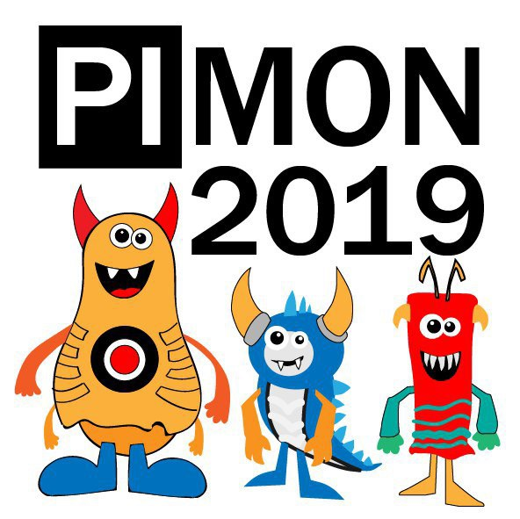
Welcome to 1st PIMON

Slide 2
NO SHIT

Slide 3
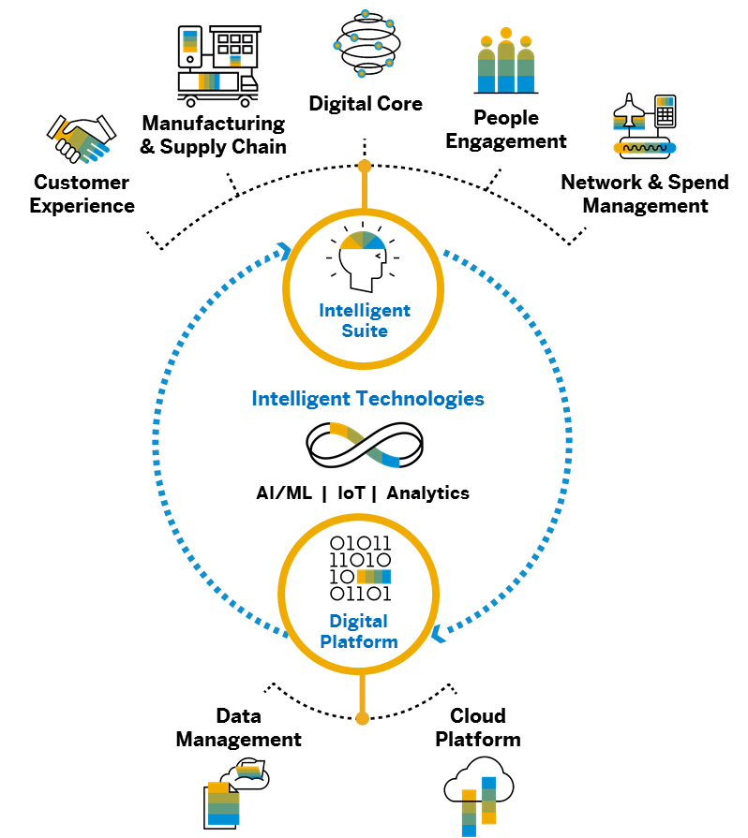




Intelligent Enterprises are Integrated Enterprises Key Integration Principles
1
2
OUT-OF-THE-BOX INTEGRATION
OPEN INTEGRATION
Integration
3
4
HOLISTIC INTEGRATION
AI-DRIVEN INTEGRATION

Slide 4
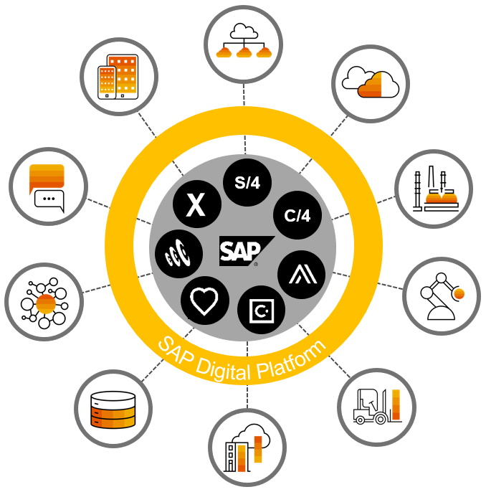
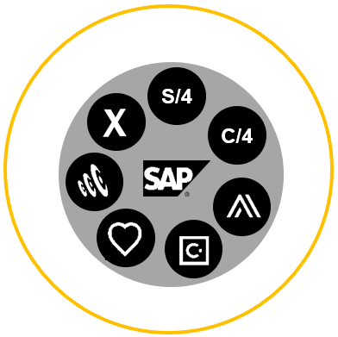
Integration Challenge for the Intelligent Enterprise Summary: Two Complementary Focus Areas for SAP
SAP Challenge SAP-to-SAP
IPaaS Challenge SAP-to-Any | Any-to-Any
Technology Guidance
Technology Guidelines
ISA-M / CIO Guides
SAP continues to deliver out-of-the box integrations for the Intelligent Suite. At the same time, SAP provides strong IPaaS capabilities as part of its business technology platform strategy to serve all integration needs in customer landscapes.
Notes:
// SaaS + attached integration

Slide 5

ENJOY THE PARTY

